Slide 1


HailBytes SAT
Security Awareness Training — deploys in your customer's own AWS or Azure tenant
PARTNER BRIEF
For HailBytes channel partners
A KnowBe4 / Proofpoint alternative without per-seat fees or vendor SaaS

Slide 2




The SAT pricing gap
Your customers want phishing simulation and training. Most pay $20–$40 per user per year. They don't have to.
Per-seat SAT charges
Email gateways cover
Neither covers
$20–$40 per user per year, billed against headcount, locked inside vendor SaaS. Every new hire is a security tax. KnowBe4, Proofpoint, Hoxhunt, Cofense.
Inbound mail filtering — Mimecast, Proofpoint TAP, M365 Defender. But filtering isn't training, and gateway dashboards aren't board reports.
Per-compute pricing that doesn't punish growth. Self-hosted training that keeps click events inside the customer's compliance boundary.
Customers learn the cost when headcount grows and the SAT bill scales with it. That's the gap HailBytes SAT closes.
2

Slide 3




What HailBytes SAT does
Phishing simulation, training, and reporting in the customer's own cloud — single VM, HA hot-hot, or auto-scaling, designed for MSSPs running 20+ tenants.
Phish
Train
Hosted phishing campaigns with branded landing pages, attachment payloads, and adversary-in-the-middle templates. SCIM 2.0 user provisioning from any IdP.
20 built-in training modules with video, adaptive spaced-repetition scheduling, SCORM 1.2 / xAPI export, and branded completion certificates.
Measure
Integrate
Per-employee risk scoring, manager / department / cohort breakdowns, repeat-offender reports, and board-ready dashboards exported to BI tools.
Mimecast, Proofpoint TAP, M365, Google Workspace, Slack, Teams, Jira / ServiceNow / Zendesk / PagerDuty, syslog / CEF SIEM, Outlook PhishAlert add-in, and an MCP server for any LLM.
Deploys via official Terraform modules (single-VM, HA, or auto-scaling) inside the customer's own AWS, Azure, AWS GovCloud, or Azure Government tenant — click events, credential captures, and training records never leave their VPC.
3

Slide 4
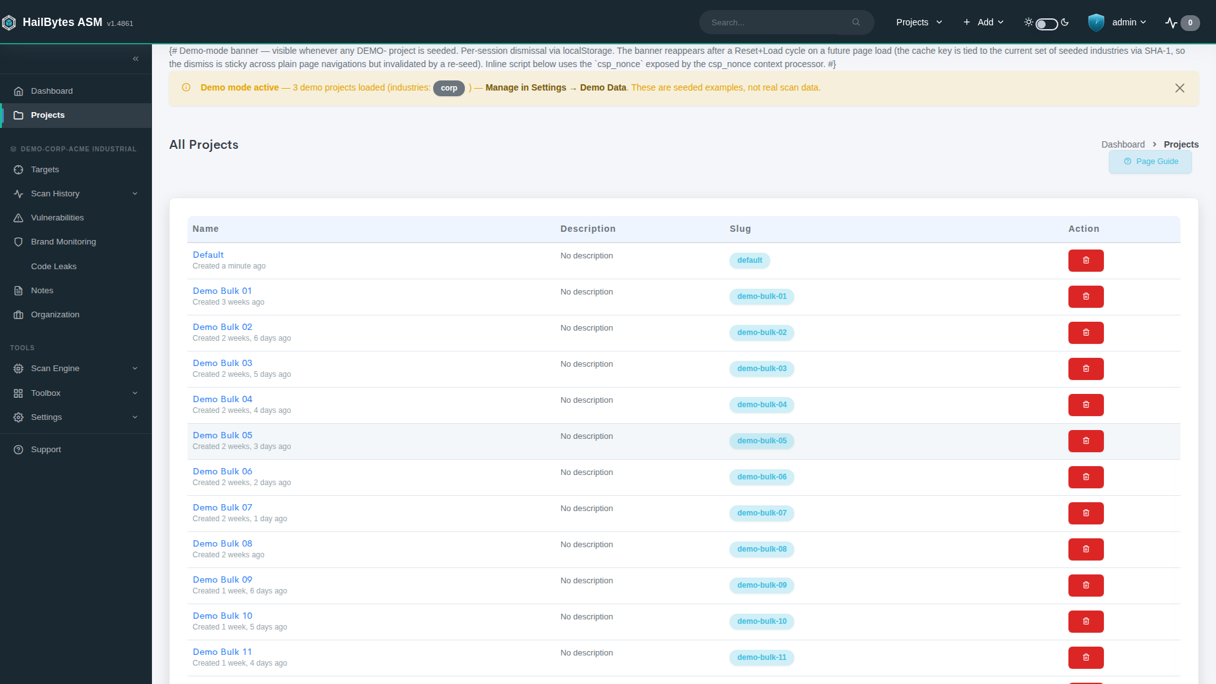
Organizations and Campaigns are used to represent distinct customer tenants, often used to distinguish between clients in MSSP / Consulting deployments.

Slide 5
Built for the operator, not the auditor
Every screen answers one of three questions an MSSP analyst is asking the Monday after a phishing campaign.
01
02
03
Who's most at risk?
Which campaigns landed?
What can the customer report on?
Repeat clickers, credential submitters, MFA-bombing-bait users — ranked by risk score, not alphabetically.
Campaign-by-campaign click-through, credential-submit, and report-as-phish rates. Trend lines, cohort comparisons, what got better and what didn't.
Board-ready exports, manager-by-manager dashboards, SOC 2 / HIPAA / PCI training evidence with completion certificates. The kind of report your customer's CISO emails up the chain.
4

Slide 6
Fits the stack you already sell
SAT sits next to the email gateway and the SIEM. It doesn't replace either; it makes both more defensible.
CrowdStrike
HailBytes SAT
Forward simulated-phish click events to the SIEM alongside production phish — the SOC sees one stream, not two.
Webhook · API
SIEM / SOAR
Phishing simulation + training + per-employee reporting
Splunk · QRadar · Sentinel · Chronicle
Wiz
PhishAlert add-in lets users report real phish from Outlook. Reported messages flow into the same SIEM pipeline as simulation results.
Pitch to your customer: "We replace your per-seat SAT vendor at 70%+ less cost, run inside your own cloud, and feed your SIEM the same way your gateway does."
5

Slide 7
Why HailBytes vs. the others
We're not trying to outspend the public-cap-table SAT vendors. We're trying to be the right answer for partners selling into mid-market.
 | HailBytes SAT | Per-seat SAT (KnowBe4 / Proofpoint) | OSS gophish
Deployment model | Runs in customer's own AWS / Azure / GovCloud tenant | Per-seat SaaS — training data on vendor infra | Self-hosted, DIY
Pricing | $0.24 / vCPU / hour, no per-asset or per-seat fees | Per-seat SaaS list price | Free — but you own the ops
MSSP / multi-tenant | First-class, designed-in | Available, often a premium SKU | DIY
AI + automation | Built-in MCP server, AI-generated phishing templates (OpenAI or Ollama) | Vendor-controlled AI features | Bring your own
SIEM/SOAR plumbing | Splunk HEC, webhooks, audit log streaming, REST API | Yes, configured per-deal | Build it yourself
Partner program | Co-sell, deal-reg, joint-named SAT offering | Channel exists but margin is thin | n/a
6

Slide 8




Partner economics
Designed so the math works for your sales team and your renewal book.
20%
Day 1
Co-sell
REVENUE SHARE
DEAL REGISTRATION
AWS CPPO + AZURE MPO
on client contracts — paid for the life of the customer
rev-share locked at registration; no recompete
Resale auth from HailBytes — draws down customer EDP / MACC commit
Case Study Program
Fast PoC turnaround
Partner portal
MSSP-ready license
12 months free + $18k (120 hours) support for evaluating clients.
Deploy in tenant; pilot in days, not weeks.
Pitch decks, battlecards, ROI calculators, Slack channel.
Multi-tenant from day one — separate Organizations per customer, no enterprise-edition gotcha.
7

Slide 9
AWS CPPO + Azure MPO
Same channel motion on both clouds. AWS Channel Partner Private Offer (CPPO) or Azure Multiparty Private Offer (MPO) — you are seller of record; AWS or Microsoft handles billing and disburses to both parties.
Resale authorization
Zero
NEW PROCUREMENT PAPERWORK
1
HailBytes (ISV) issues a Resale Authorization to you on AWS Marketplace (CPPO) or extends a Multiparty Private Offer on Azure Marketplace (MPO) with the agreed wholesale price.
Customer's AWS or Azure account, customer's terms — no fresh legal review.
Partner creates the offer
1-click
FOR CUSTOMERS ON AWS OR AZURE ALREADY
2
You set the customer-facing price, contract length, and any bundled services, then extend the CPPO or MPO to the customer.
Subscribe from AWS Marketplace or Azure Marketplace, deploy in minutes inside their own tenant.
Subscribe + disburse
Stack
MARKETPLACE MARKUP + REV SHARE
3
Customer accepts in their AWS or Azure console. The marketplace pays HailBytes the wholesale price and you the markup. CPPO spend draws down AWS EDP commit; MPO spend draws down Microsoft MACC commit.
You earn the CPPO or MPO markup AND the partner-program rev share — the two are additive, not competing.
HailBytes on AWS Marketplace and Azure Marketplace. Register at hailbytes.com/partners for your resale authorization.
8

Slide 10


What a good HailBytes deal looks like
So your team knows when to lead with SAT vs. attach it to an email-security or compliance motion.
Ideal customer profile
Buying triggers
200 – 5,000 employees; regulated, growth-stage tech, or compliance-driven (SOC 2, HIPAA, PCI)
Renewal coming up on per-seat SAT vendor
Paying per-seat for KnowBe4, Proofpoint, Hoxhunt, or Cofense — or running gophish DIY
Failed phishing test, data residency requirement, or audit finding
AWS- or Azure-committed (active EDP / MACC credits, Marketplace procurement preferred)
Audit / compliance ask (SOC 2, HIPAA, FedRAMP prep)
Headcount growing — SAT bill scaling faster than security budget
New CISO doing a 90-day security-program review
9

Slide 11
PoC path — short, scripted, repeatable
Two-week pilot. Customer hands us a user list and a target inbox; we hand back a baseline campaign and trainee analytics.
Day 0
Day 1-3
Day 4-10
Day 11-14
Kickoff
Discovery
Triage
Decision
User list (SCIM or CSV), scope, success criteria, named DRI on both sides.
Baseline phishing simulation sent to a seed group, click / submit / report rates dropped into shared review doc.
Joint working session: which cohorts to train first, what to integrate (Mimecast, SIEM, ticketing).
Campaign report, pricing, paper. Or fail fast and we both learn something.
HailBytes brings the engineer. You bring the customer relationship. For longer evaluations, the Case Study Program offers 12 months in exchange for feedback.
10

Slide 12
Where we are, where we're going
Honest snapshot — what's shipping, what's next, and what we'd rather de-risk before signing partners.
Shipping today
Next 90 days
What we tell partners up front
Adaptive spaced-repetition training, AI-generated phishing templates (MCP server)
Native HRIS provisioning (Workday, BambooHR)
Founder-led — fast moves, small team
SSO via OIDC + SAML, SCIM 2.0, audit log streaming
AI-personalized training paths
Email-gateway and HRIS integrations are webhook / SCIM today, with native connectors shipping in Q3 ‘26.
Mimecast, Proofpoint TAP, M365, Google Workspace gateway connectors
Expanded MSSP role-based access
Per-tenant deploy means partner-side ops lift
GovCloud + Azure Government deploy targets
Customer-facing scheduled reports
We'd rather under-promise and ship clean
11

Slide 13
Where we'd like to go from here
Three concrete next steps — pick any combination.
01
02
03
Joint account list
Pilot or case study
Partner agreement
Identify 5 – 10 mutual targets renewing a per-seat SAT vendor in the next 12 months.
Run the 2-week PoC or enroll a customer in the 12-month Case Study Program. We bring the engineer.
20% rev share, deal-reg, AWS Marketplace (CPPO) and Azure Marketplace (MPO) co-sell. Term sheet to your team within five business days.
David McHale · Principal, HailBytes · david@hailbytes.com

