Slide 1


HailBytes ASM
Attack Surface Management — deploys in your customer's own AWS or Azure tenant
PARTNER BRIEF
For HailBytes channel partners
Filling the ASM slot alongside the EDR, CSPM, and SIEM stack you already sell

Slide 2




The portfolio gap
Your stack covers endpoint and cloud — but external exposure is its own discipline.
EDR covers
CSPM covers
Neither covers
Endpoints, identities, and workloads you've already deployed agents on. CrowdStrike, SentinelOne, Defender for Endpoint.
Cloud posture inside the AWS, Azure, or GCP accounts your customer has handed you keys to. Wiz, Prisma Cloud, Defender for Cloud.
The attacker's view from the outside. Shadow subdomains, forgotten assets, exposed services your customer doesn't know they own.
Customers find out from a breach disclosure, a researcher email, or a Shodan screenshot. That's the gap ASM closes.
2

Slide 3




What HailBytes ASM does
Continuous external discovery, prioritized findings, designed for the operator running 20+ tenants.
Discover
Monitor
Subdomains, IPs, ports, certs, exposed services. First-party AWS, Azure, GCP, and Cloudflare connectors for cloud-asset enumeration.
Recurring scans on the cadence you set. New asset appears; you see it before the attacker does.
Prioritize
Integrate
AI-powered analysis (OpenAI or local Ollama) plus exposure clustering across the asset graph — operator sees what changed and what hurts.
Splunk HEC, SIEM/SOAR webhooks, audit log streaming, REST API, and a built-in MCP server so AI agents can drive scans and query findings.
Deploys via official Terraform modules (single-VM, HA, or auto-scaling) inside the customer's own AWS, Azure, AWS GovCloud, or Azure Government tenant — recon data never leaves their VPC.
3

Slide 4
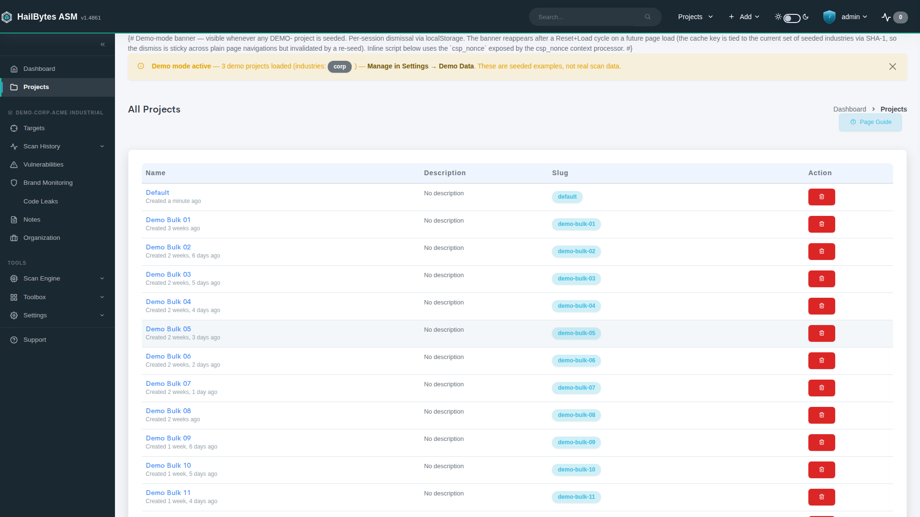
Projects are used to represent distinct sets of Targets, often used to distinguish between clients in MSSP / Consulting deployments.

Slide 5
Built for the operator, not the auditor
Every screen answers one of three questions an MSSP analyst is asking at 8am.
01
02
03
What's new?
What's worse than expected?
What can be closed today?
Net-new assets and services since the last scan. Sorted by risk, not by alphabet.
Findings that escalated, exposures that grew, certs about to expire on assets you didn't know existed.
High-confidence, low-effort wins. The kind of progress your MSSP analyst can show a customer in their weekly.
4

Slide 6
Fits the stack you already sell
ASM is the outside-in view. EDR and CSPM are inside-out. The story writes itself.
EDR
HailBytes ASM
Correlate exposed assets with endpoint coverage — find the host that isn't running the EDR agent your customer is paying for.
HEC · Webhook
SIEM / SOAR
Continuous external discovery + prioritized findings
Splunk · QRadar · Sentinel · Chronicle
CSPM
Cross-check external exposure against connected cloud accounts — flag shadow infrastructure outside the CSPM's scanned scope.
Pitch to your customer: "We see what your EDR + CSPM can't — and route findings into the SIEM you're already paying for."
5

Slide 7
Why HailBytes vs. the others
We're not trying to outspend the public-cap-table ASMs. We're trying to be the right answer for partners selling into mid-market.
 | HailBytes ASM | Big-cap ASM (Censys / Palo Alto Xpanse) | OSS reNgine
Deployment model | Runs in customer's own AWS / Azure / GovCloud tenant | SaaS — recon data on vendor infra | Self-hosted, DIY
Pricing | $0.24 / vCPU / hour, no per-asset or per-seat fees | Per-asset SaaS list price | Free — but you own the ops
MSSP / multi-tenant | First-class, designed-in | Available, often a premium SKU | DIY
AI + automation | Built-in MCP server, AI-powered analysis (OpenAI or Ollama) | Vendor-controlled AI features | Bring your own
SIEM/SOAR plumbing | Splunk HEC, webhooks, audit log streaming, REST API | Yes, configured per-deal | Build it yourself
Partner program | Co-sell, deal-reg, joint-named ASM offering | Channel exists but margin is thin | n/a
6

Slide 8




Partner economics
Designed so the math works for your sales team, your SOC, and your renewal book.
20%
Day 1
Co-sell
REVENUE SHARE
DEAL REGISTRATION
AWS CPPO + AZURE MPO
on client contracts — paid for the life of the customer
rev-share locked at registration; no recompete
Resale auth from HailBytes — draws down customer EDP / MACC commit
Case Study Program
Fast PoC turnaround
Partner portal
MSSP-ready license
12 months free + $18k (120 hours) support for evaluating clients.
Deploy in tenant; pilot in days, not weeks.
Pitch decks, battlecards, ROI calculators, Slack channel.
Multi-tenant from day one — no enterprise-edition gotcha.
7

Slide 9
AWS CPPO + Azure MPO
Same channel motion on both clouds. AWS Channel Partner Private Offer (CPPO) or Azure Multiparty Private Offer (MPO) — you are seller of record; AWS or Microsoft handles billing and disburses to both parties.
Resale authorization
Zero
NEW PROCUREMENT PAPERWORK
1
HailBytes (ISV) issues a Resale Authorization to you on AWS Marketplace (CPPO) or extends a Multiparty Private Offer on Azure Marketplace (MPO) with the agreed wholesale price.
Customer's AWS or Azure account, customer's terms — no fresh legal review.
Partner creates the offer
1-click
FOR CUSTOMERS ON AWS OR AZURE ALREADY
2
You set the customer-facing price, contract length, and any bundled services, then extend the CPPO or MPO to the customer.
Subscribe from AWS Marketplace or Azure Marketplace, deploy in minutes inside their own tenant.
Subscribe + disburse
Stack
MARKETPLACE MARKUP + REV SHARE
3
Customer accepts in their AWS or Azure console. The marketplace pays HailBytes the wholesale price and you the markup. CPPO spend draws down AWS EDP commit; MPO spend draws down Microsoft MACC commit.
You earn the CPPO or MPO markup AND the partner-program rev share — the two are additive, not competing.
HailBytes on AWS Marketplace and Azure Marketplace. Register at hailbytes.com/partners for your resale authorization.
8

Slide 10


What a good HailBytes deal looks like
So your team knows when to lead with ASM vs. attach it to an EDR or CSPM motion.
Ideal customer profile
Buying triggers
200 – 5,000 employees; regulated, growth-stage tech, or Silicon Slopes profile
Recent acquisition, divestiture, or rebrand
Already running CrowdStrike or Wiz — no ASM in the stack today
Failed pen test or red-team finding on a forgotten asset
AWS- or Azure-committed (active EDP / MACC credits, Marketplace procurement preferred)
Audit / compliance ask (SOC 2, HIPAA, FedRAMP prep)
Acquisitive or distributed — surface they don't fully inventory
New CISO doing a 90-day attack-surface inventory
9

Slide 11
PoC path — short, scripted, repeatable
Two-week pilot. Customer hands us seed domains; we hand back a findings review.
Day 0
Day 1-3
Day 4-10
Day 11-14
Kickoff
Discovery
Triage
Decision
Seed domains, scope, success criteria, named DRI on both sides.
Initial scan, asset inventory, baseline findings dropped into shared review doc.
Joint working session: which findings matter, what to integrate (Splunk, ticketing).
Findings report, pricing, paper. Or fail fast and we both learn something.
HailBytes brings the engineer. You bring the customer relationship. For longer evaluations, the Case Study Program offers 12 months in exchange for feedback.
10

Slide 12
Where we are, where we're going
Honest snapshot — what's shipping, what's next, and what we'd rather de-risk before signing partners.
Shipping today
Next 90 days
What we tell partners up front
Recurring scans, AI-powered analysis (MCP server)
Native EDR asset correlation (CrowdStrike, SentinelOne)
Founder-led — fast moves, small team
SSO via OIDC + SAML, audit log streaming
Native CSPM cloud-asset cross-check (Wiz, Defender for Cloud)
EDR + CSPM integrations are webhook-bridged today, with native support shipping in Q3 ‘26.
First-party AWS/Azure/GCP/Cloudflare connectors
Expanded MSSP role-based access
Per-tenant deploy means partner-side ops lift
GovCloud + Azure Government deploy targets
Customer-facing scheduled reports
We'd rather under-promise and ship clean
11

Slide 13
Where we'd like to go from here
Three concrete next steps — pick any combination.
01
02
03
Joint account list
Pilot or case study
Partner agreement
Identify 5 – 10 mutual targets where ASM strengthens your EDR or CSPM motion.
Run the 2-week PoC or enroll a customer in the 12-month Case Study Program. We bring the engineer.
20% rev share, deal-reg, AWS Marketplace (CPPO) and Azure Marketplace (MPO) co-sell. Term sheet to your team within five business days.
David McHale · Principal, HailBytes · david@hailbytes.com

